Slide 1
Transfer Learning
Group: TLDR; Transfer Learning Did Reproduce

Slide 2
Training Neural Networks
Computationally expensive
Time consuming
Need lots of labelled data
⏰
GPU
Transfer Learning Reduces All Three
Pretrained Network
Retrain subset of params
Transfer network
parameters

Slide 3
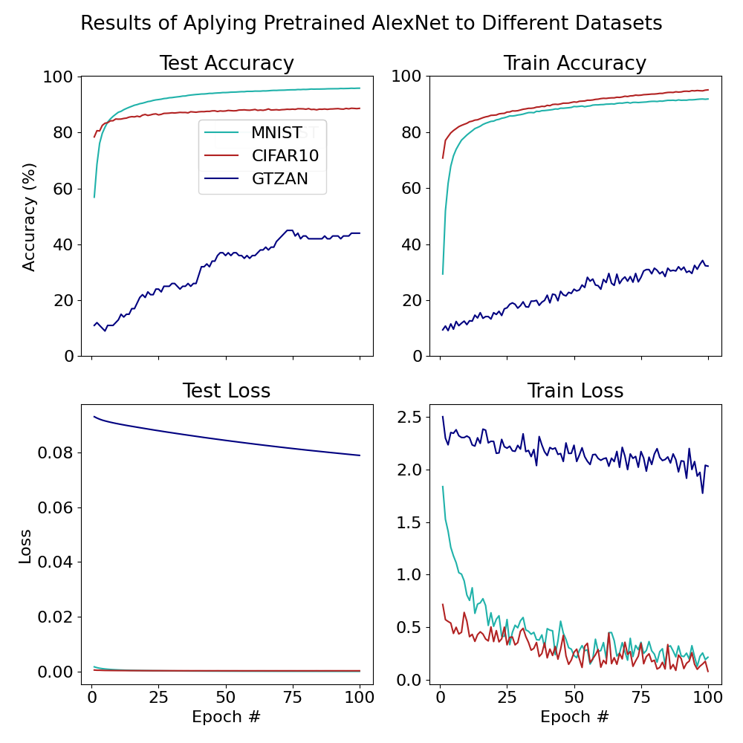
How does the performance of transfer learning depend on domain similarity?
Model:
AlexNet pretrained on Imagenet
Datasets:
MNIST
  Images
CIFAR10
  Images
GTZAN
  Audio clips from 10 music genres

Slide 4
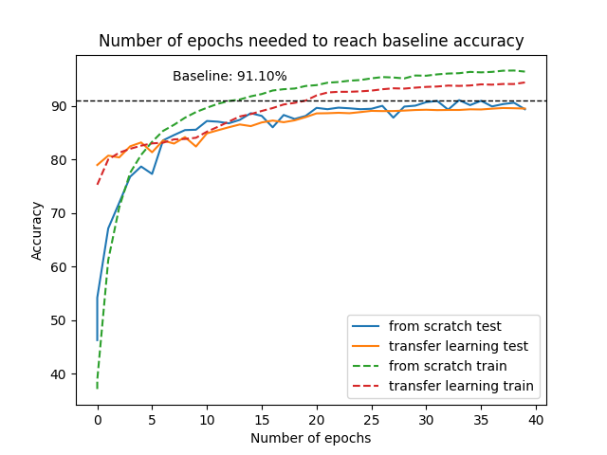
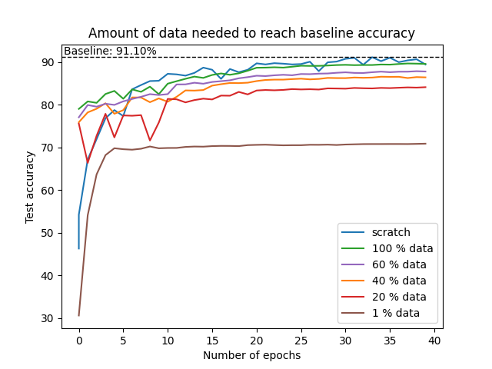
How does transfer learning affect computation time & data needs?
Model: ResNet-50
Pretraining on dataset (120 epochs) : CIFAR-100
Target dataset: CIFAR-10

Slide 5
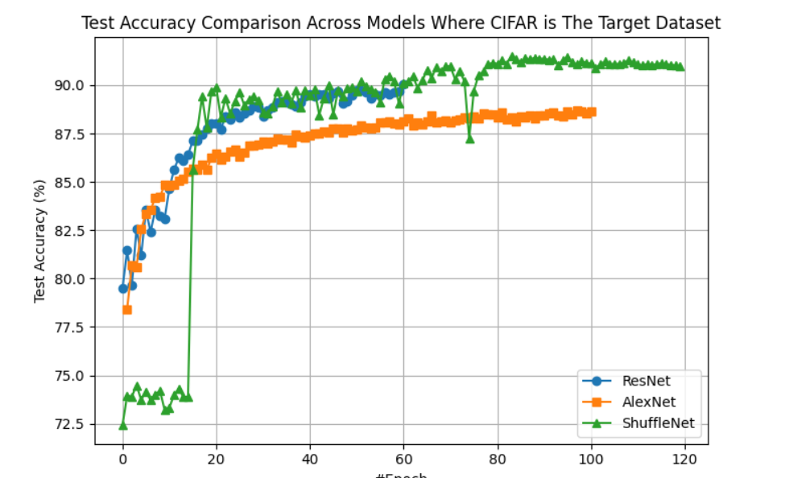
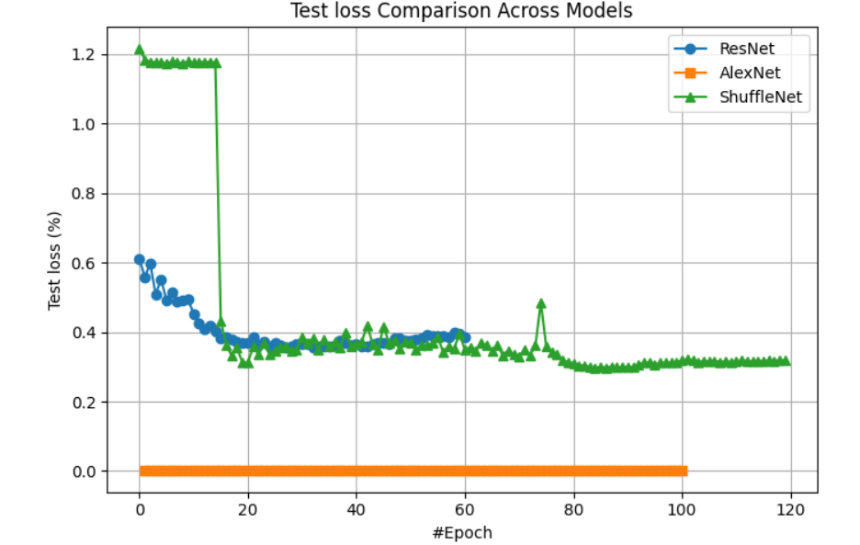
Can Compact Model Achieve Performance Comparable To
Complex Model
Model: Shuffle_Net Parameter Count
Source Dataset: ImageNet
Target Dataset:
CIFAR10, images, 10 classes
Alex_Net | 61 m
Res_Net | 25.6 m
Shuffle_Net | 2.3 m

Slide 6
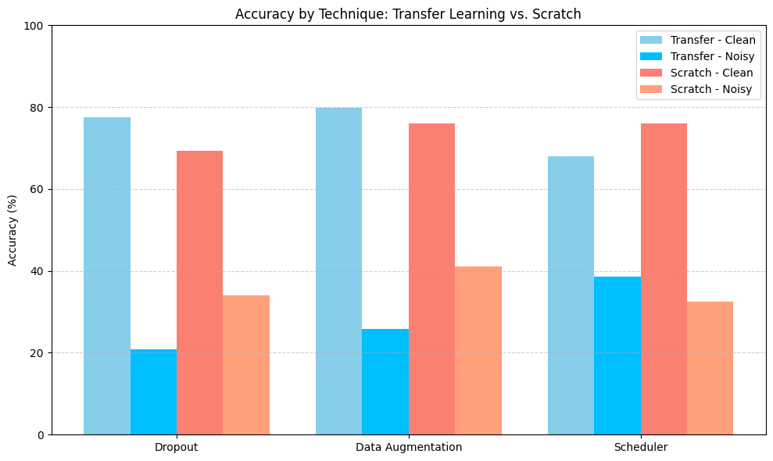
Does transfer learning lead to more robust (consistent) predictions?
Model: ResNet (Transfer Learning, Scratch)
Data: CIFAR-10
Tests: Clean, Noisy (Gaussian)
🔹 Transfer Learning:
Best on clean data
Benefits from longer training
🔹 Scratch Training:
Stronger on noisy data with dropout
Dropout boosts noisy accuracy (peak: 41.02%)
🔹 Scheduler:
Stabilizes training
Less effective than dropout

Slide 7
Summary
Efficacy of TL depends on domain similarity
TL reduces computational resources and amount of data required
Compact models performs on par with complex models in TL
TL did not produce more robust predictions in our configuration

